Slide 1
ENSE 496ab, Milestone 2
!Cool
Team Members:
Christian John
Ahmed Shamiss
Jeremy Cross
Evan Geissler
Taylen Jones
Dakota Fisher
11th October, 2018

Slide 2
Team !Cool
We are team !Cool and and our group members are:
Christian John
Ahmed Shamiss
Jeremy Cross
Evan Geissler
Taylen Jones
Dakota Fisher
We are assigned to the Weekend Warriors project

Slide 3
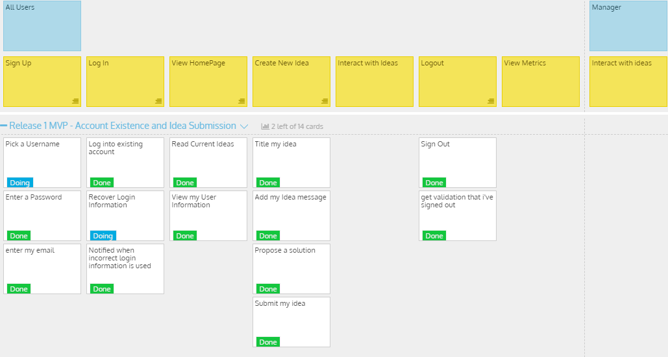
Updated USM

Slide 4
DEMO TIME !!!

Slide 5
Comments/Discussion
Successes
We completed most of our release 1 goals
Barriers to success
Github difficulties
Having trouble pushing/pulling
Mac users had trouble using the database to login

Slide 6
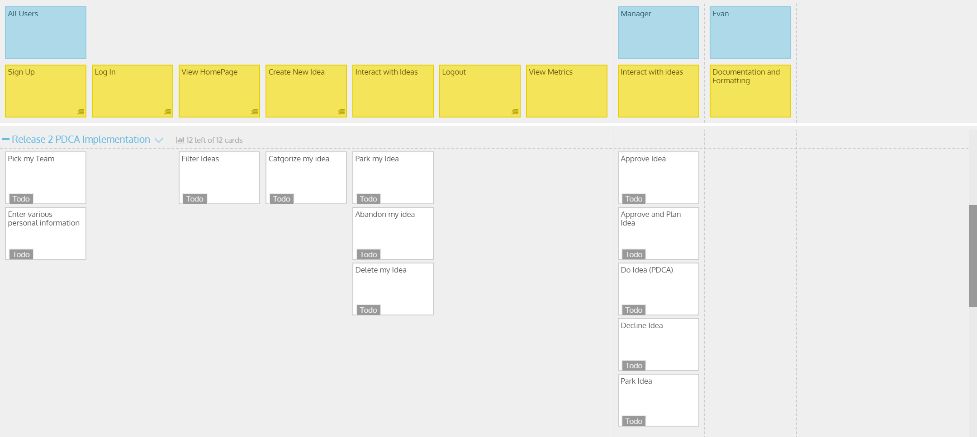
Sprint 2 Deliverables

Slide 7
Group reflection
How did you feel about this milestone? What did you like about it? What did you dislike?
Excellent
Liked Partial html pages
MySql was not our friend
What did you learn about yourself as you collaborated and worked through this milestone?
WE LOVE ASP.NET /s

Slide 8
Group reflection
How will you use what you have learned going forward?
Produce better Webpages
What “stuff & things” related to this milestone would you want help with?
Database complications

